Slide 1
Pivotal Platform - Journey

Slide 2
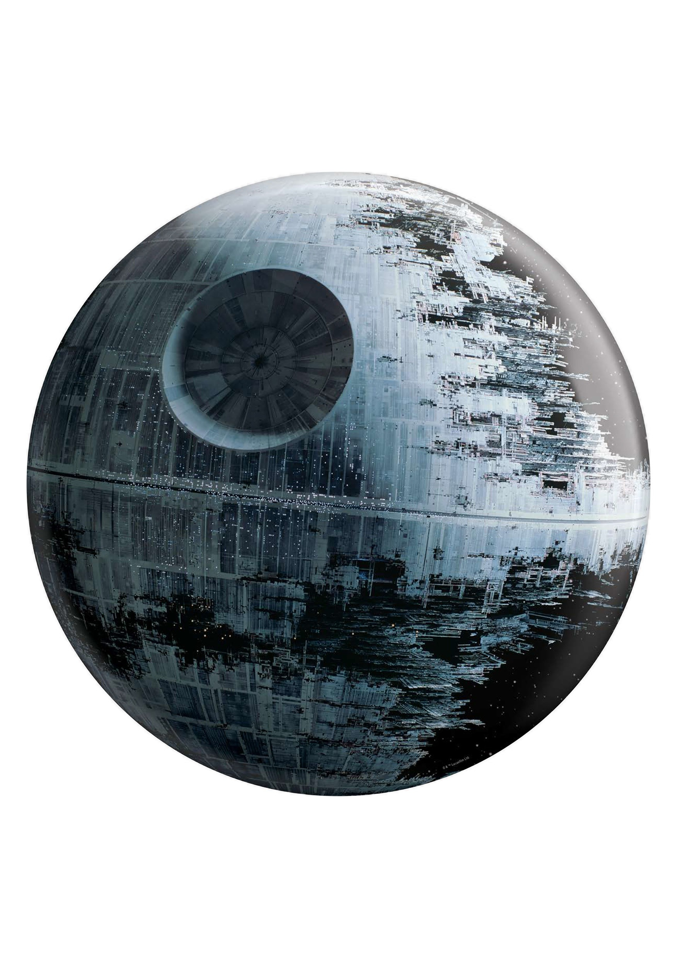
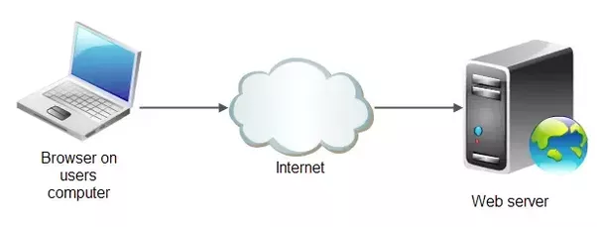

In the beginning...
DeathStar
Yoda

Slide 3
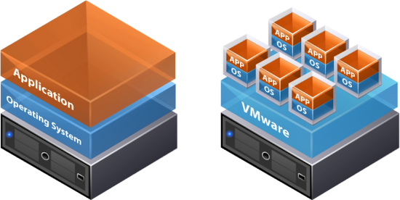
And then came virtualization...
DeathStar1
Endor
Yavin

Slide 4
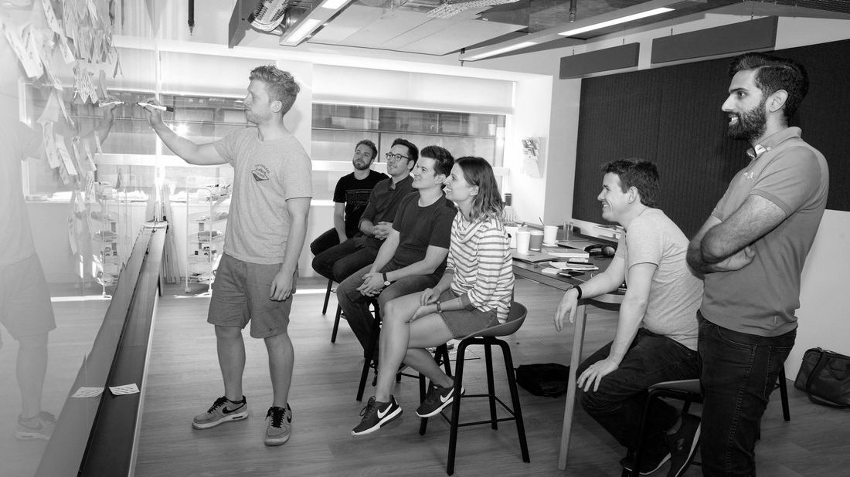
IaaS

Slide 5
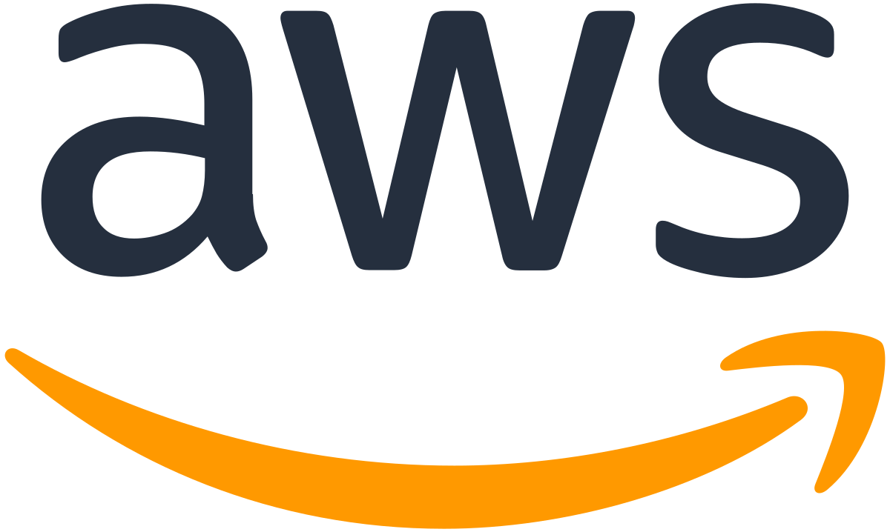
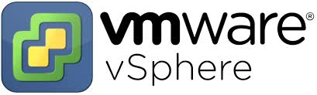
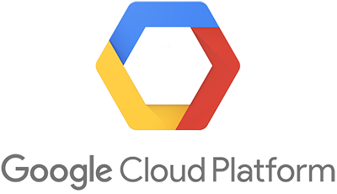
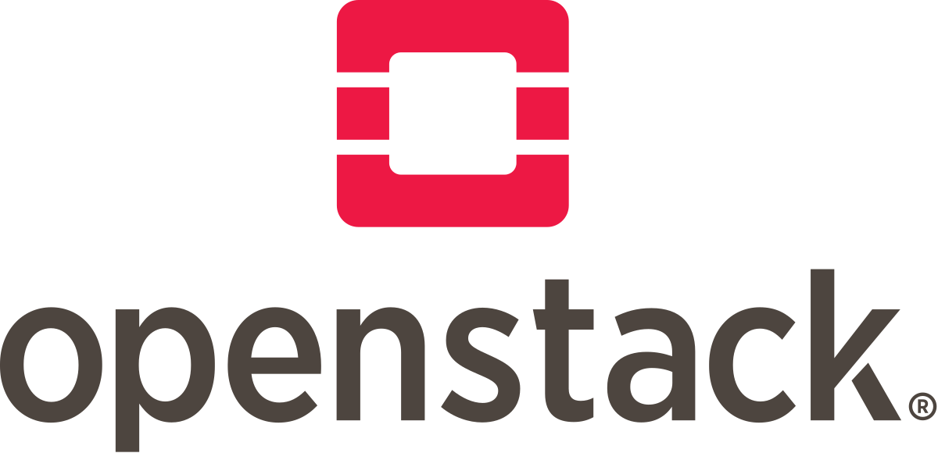
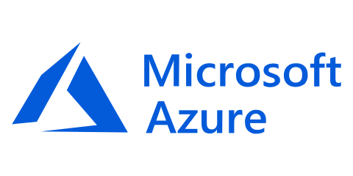
IaaS is great at what it does

Slide 6
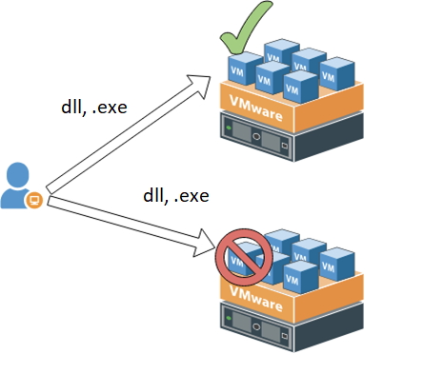
Works on my vm...

Slide 7
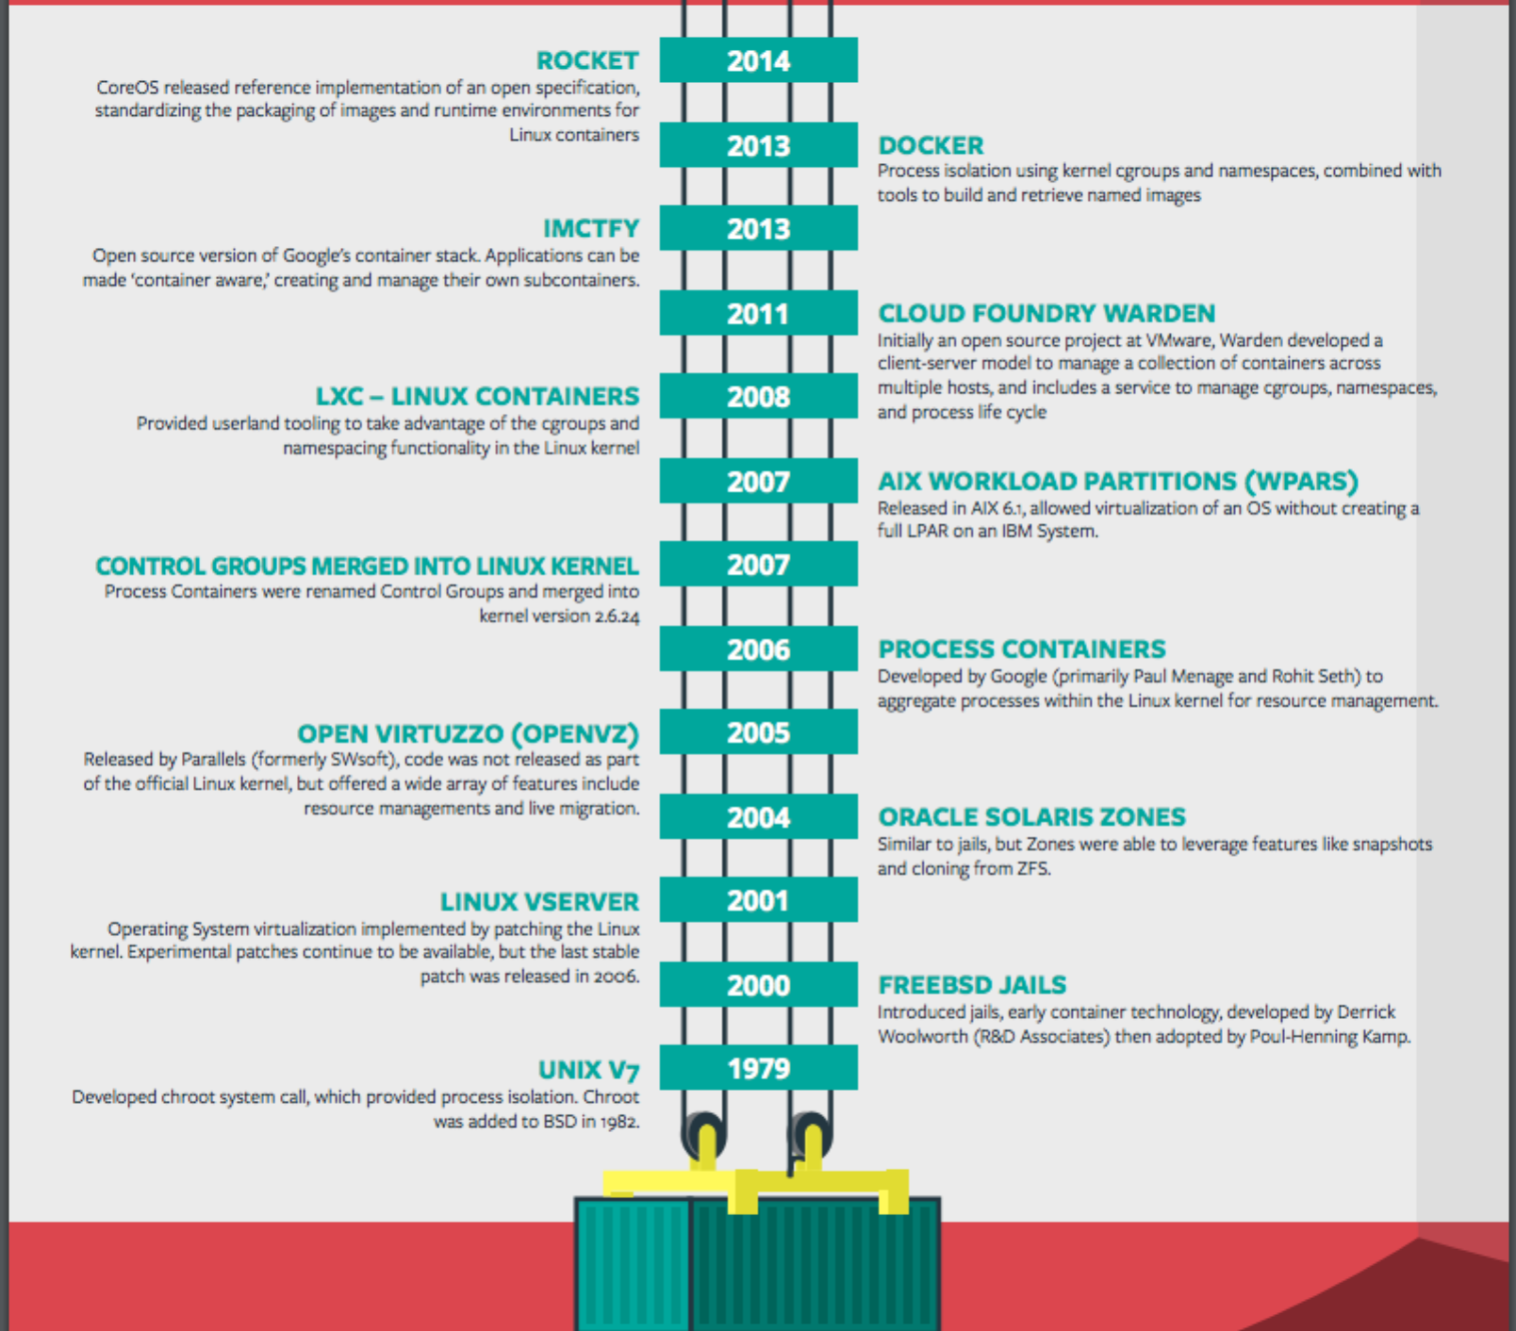
Brief History of Containers
2006: Rohit Seth and Paul Menage introduced the concept of Control groups
2011: Warden was developed by Pieter Noordius and others at Vmware
2013: Docker was developed at DotCloud
2014: Warden rewritten in Go into Garden by Alex Suraci and others.

Slide 8
Containers
Cgroups (control groups): hierarchical controls for CPU, RAM, I/O, network, PID, Devices; control “what a process is able to do”
Each process belongs to a cgroup of each type
CPU
cgroup
RAM
cgroup
I/O
cgroup
Network
cgroup
PID
cgroup
Devices
cgroup
namespaces: control “what a process is able to see” for IPC queues, Network, FS Mounts, PID, User, UTS
Each process is in one namespace of each type. The process’s namespace is destroyed when it exits
Process 1: internal PID 0, port 8080
Process 2: internal PID 0, port 8080
Process 3: internal PID 0, port 8080
Process 4: internal PID 0, port 8080
IPC
Netwrk
Mount
PID
User
UTS

Slide 9
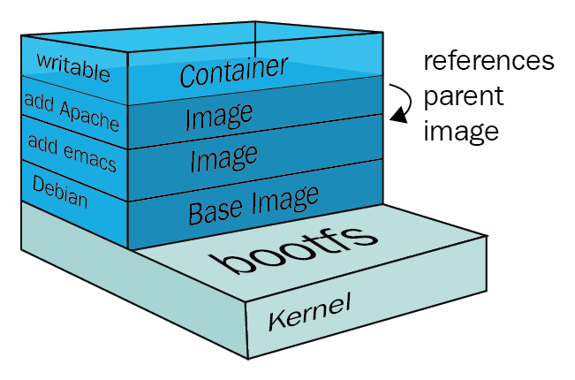
Filesystem Layers

Slide 10
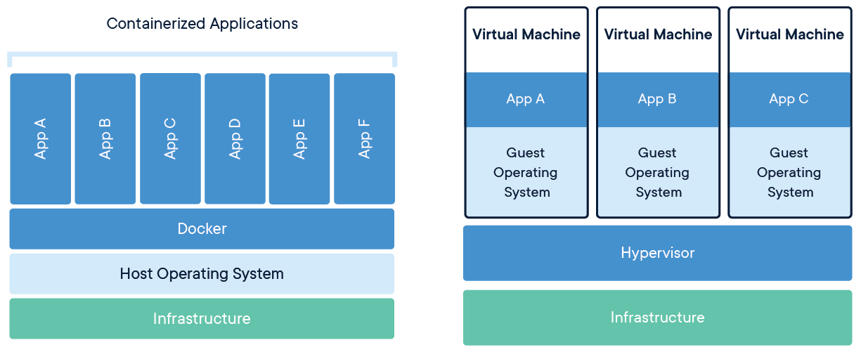
Docker

Slide 11
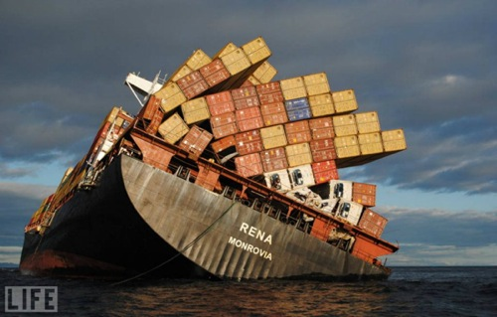
Containers everywhere...

Slide 12
CaaS

Slide 13
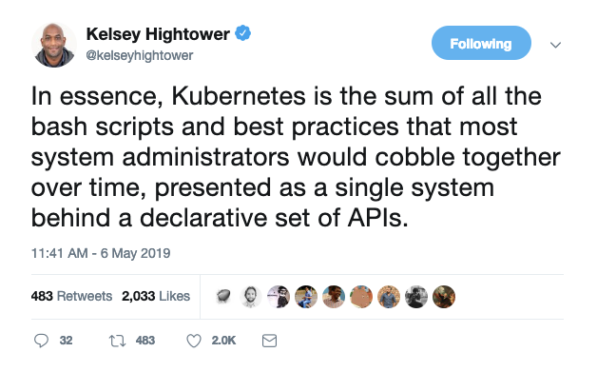
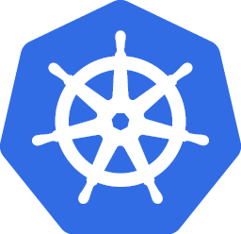
Kubernetes
Kubernetes is an open-source platform designed to automate deploying, scaling, and operating application containers.
With Kubernetes, you are able to quickly and efficiently respond to customer demand:
Deploy your applications quickly and predictably.
Scale your applications on the fly.
Roll out new features seamlessly.
Limit hardware usage to required resources only.
Manage your applications like cattle instead of pets.
https://kubernetes.io/docs/concepts/overview/what-is-kubernetes/
Notes:
A Production-Grade Container Orchestration System
Originally designed by Google and donated to the Cloud Native Computing Foundation.

Slide 14
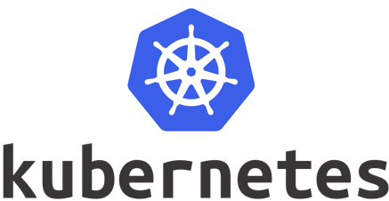
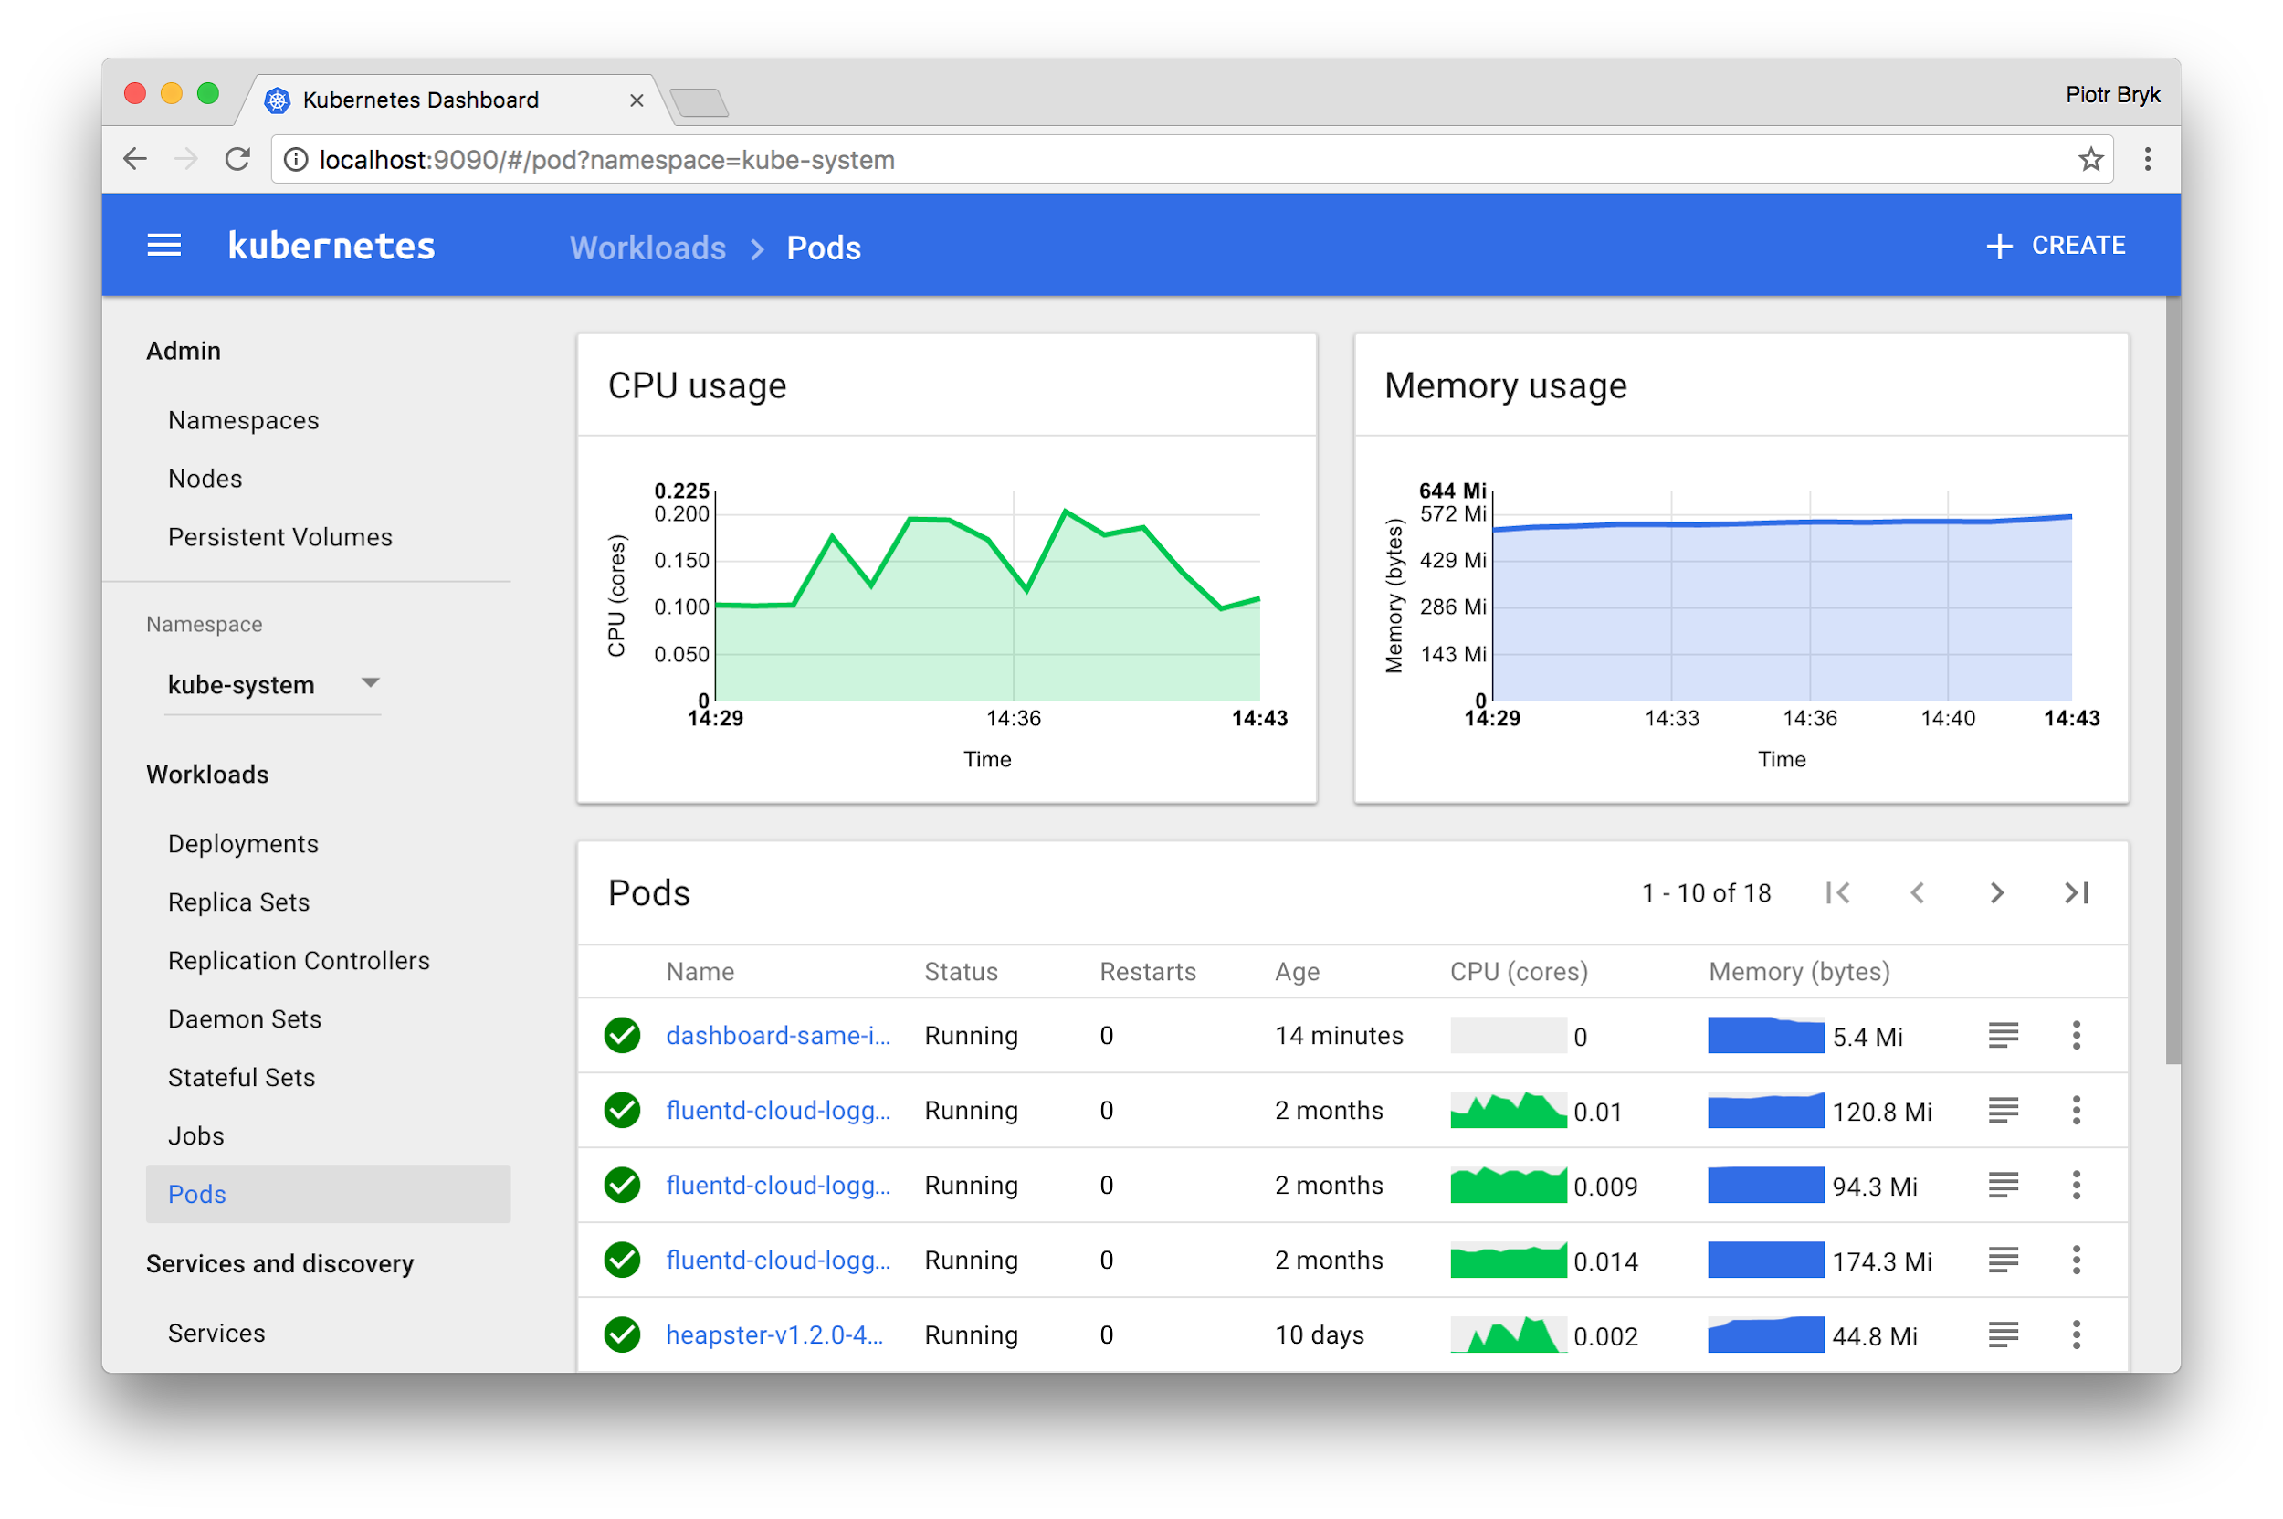
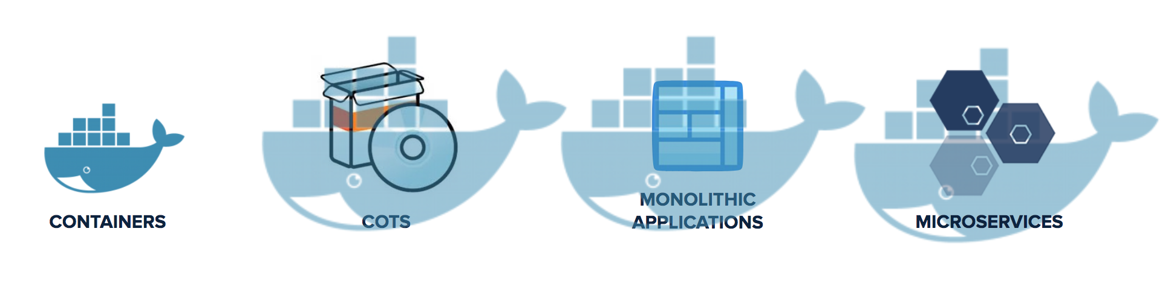
Kubernetes is a Runtime for Containerized Workloads
App User
Dev / Apps
IT / Ops
> kubectl
Kubernetes Dashboard
Compute
Storage
Networking
Notes:
As you can see, there are many operation considerations to operate Kubernetes in production (talk through a few) <click>

Slide 15
...but Kubernetes alone is not enough for enterprises
App User
Load Balancing / Routing
Dev / Apps
IT / Ops
Container Image
Registry
External
Data Services
> kubectl
Command Line / API
App Monitoring
Cluster Provisioning
App Logging
Management GUI
Kubernetes Dashboard
Monitoring GUI
OS Updates
K8S Updates
Log & Monitor
Backup & Restore
OS Images
K8S Images
Recover & Restart
Provision & Scale
Compute
Storage
Networking
Notes:
As you can see, there are many operation considerations to operate Kubernetes in production (talk through a few) <click>
RBAC / User Management

Slide 16
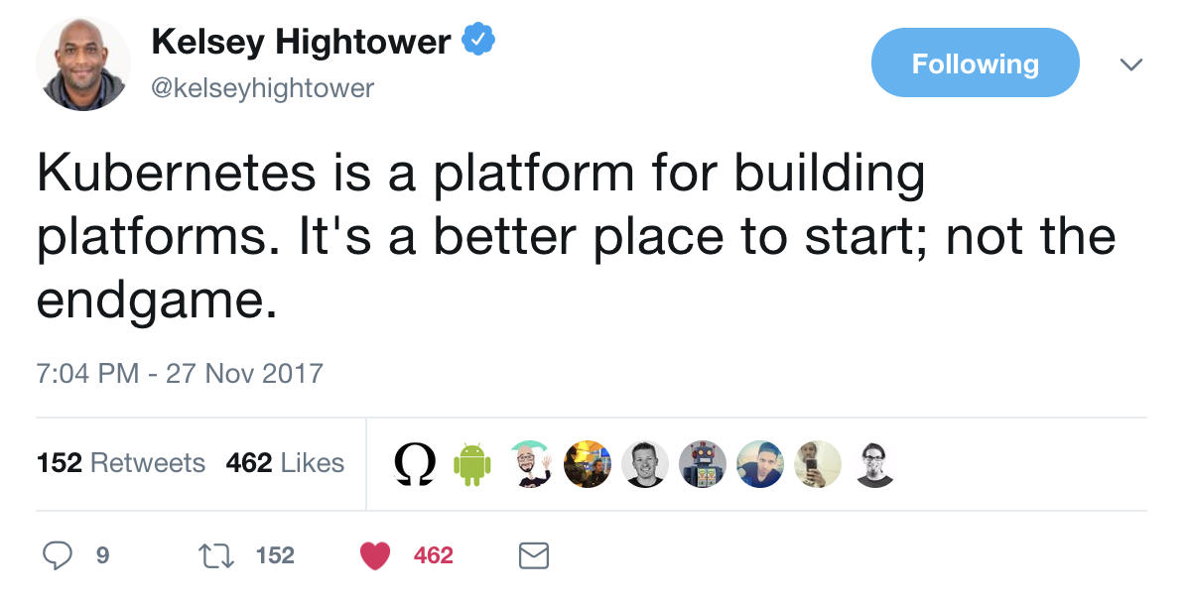
...but Kubernetes alone is not enough for enterprises
App User
Load Balancing / Routing
Dev / Apps
External
Data Services
IT / Ops
Container Image
Registry
> kubectl
Cluster Provisioning
Command Line / API
App Monitoring
App Logging
Management GUI
Kubernetes Dashboard
OS Updates
K8S Updates
Log & Monitor
Backup & Restore
Monitoring GUI
OS Images
K8S Images
Recover & Restart
Provision & Scale
Compute
Storage
Networking
Notes:
As you can see, there are many operation considerations to operate Kubernetes in production (talk through a few) <click>
RBAC / User Management

Slide 17
Microservices

Slide 18
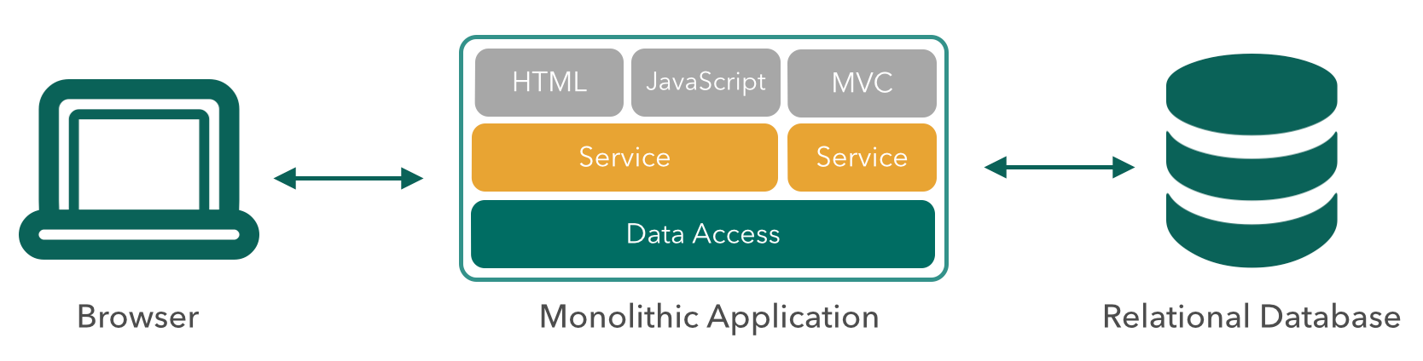
Traditional Architecture
Notes:
A turnkey solution (OpsManager tile + PKS API) to provision, operate and manage enterprise grade Kubernetes clusters
Enterprise grade - No assembly required: OS, Registry, K8s, networking, storage included

Slide 19
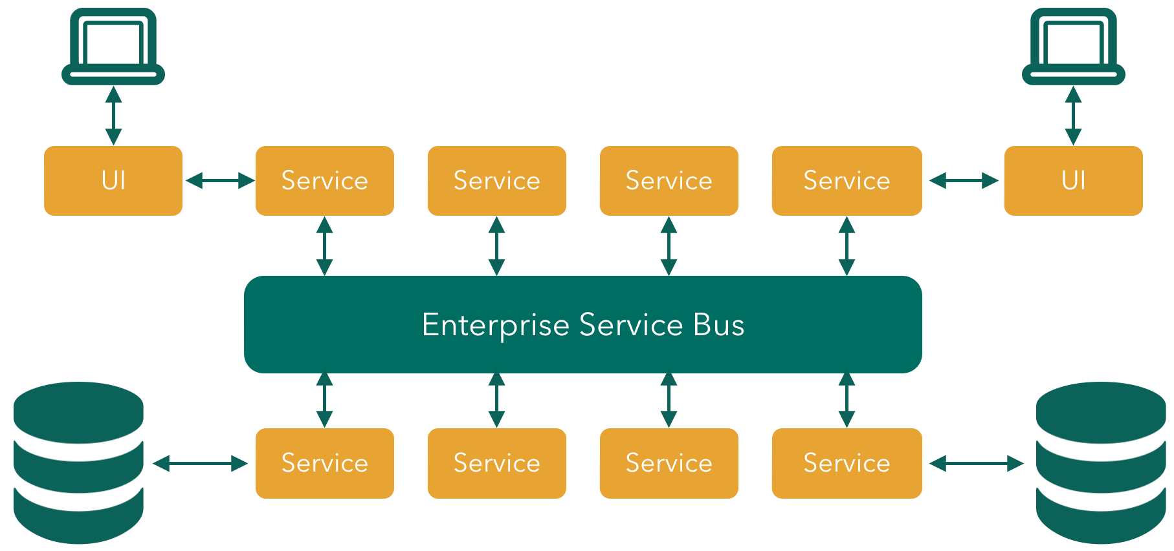
More than ESBs
Notes:
A turnkey solution (OpsManager tile + PKS API) to provision, operate and manage enterprise grade Kubernetes clusters
Enterprise grade - No assembly required: OS, Registry, K8s, networking, storage included

Slide 20
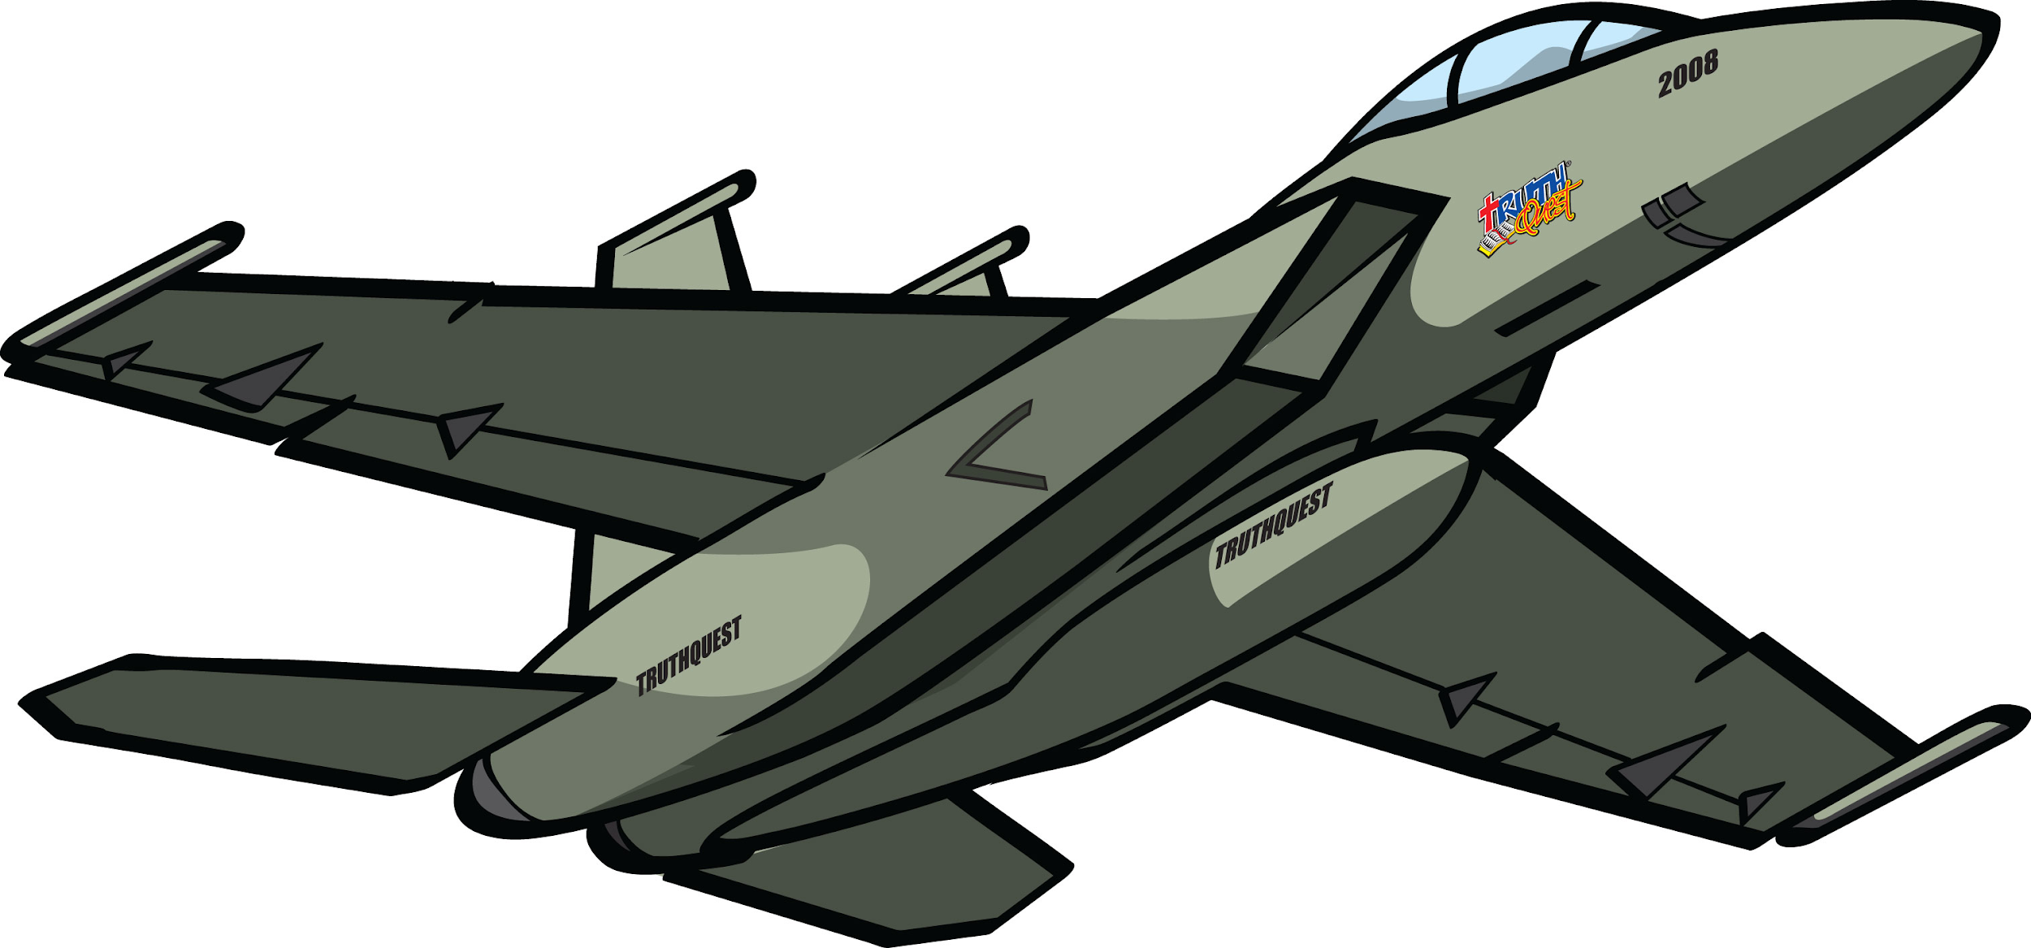

From Monolith to Microservices!
Improved Productivity and Speed
Development can occur in parallel, no waiting for other microservices to finish
High Scalability and Flexibility
Adding and scaling microservices becomes painless since they are decoupled
Easier to Build and Maintain Apps
Deployed and managed independently
Problems do not influence the entire system
Organized Around Business Capabilities
Built around business capabilities, not technologies
Ability to be reused in different business channels

Slide 21
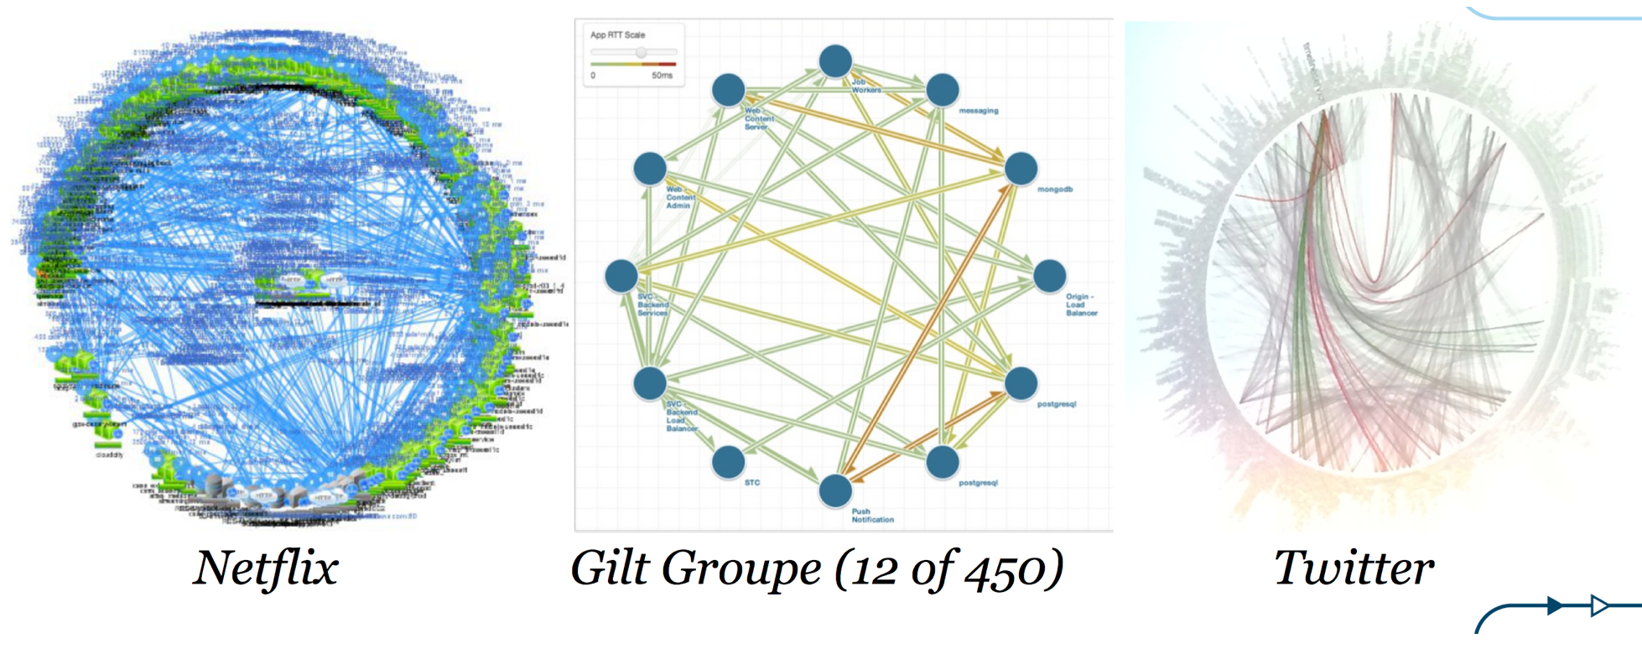
Microservices!!!

Slide 22
Cloud Native Challenges
Environment Config
How to configure 30 instances of my microservice?
How to update a configuration without impacting availability?
Service Tracing
What service failed?
How to debug when a single API call triggers 30 subsequent calls?
Discovering Services
Which services are available?
Where are the services we need?
What to do when an external service is down?
How to heal when an external service is down?
How to notify when an external service is down?
Handling Failure

Slide 23
PaaS

Slide 24
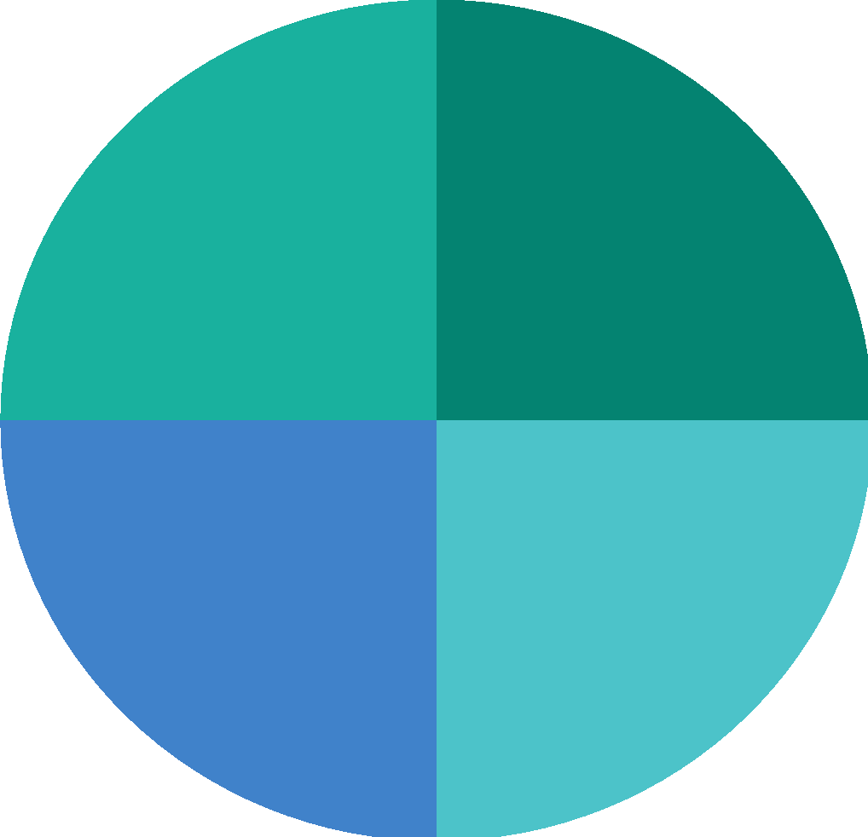




Cloud Native
Cloud Computing:
On demand, network available, distributed, ephemeral
Cloud Native:
Applications, platforms, operations that assume a cloud environment.
Cloud Native Architecture:
Patterns we implement that take advantage of the cloud.
DevOps
Continuous
Delivery
Micro services
Containers

Slide 25
Essential Elements of an Enterprise PaaS
Consolidated technology stack to support multiple languages and frameworks
Built-in and natively managed marketplace of services
Enhanced dashboards for app owners
Operational Agility Essential for Enterprise PaaS
Enact enterprise policy controls and governance
Scale to meet peak user demands while reducing hardware costs
Designed for high application availability (HA)
Application monitoring and metrics
Flexibility to run your app on any infrastructure cloud
Built for modern design and development practices

Slide 26
FaaS

Slide 27
Abstractions
AWS Lambda, Azure Functions, OpenWhisk, kubeless, PFS
FaaS
PCF, Azure App Service, Heroku
PaaS
PKS, GKE, OpenShift, AWS Fargate, Kubernetes
CaaS
AWS, Microsoft Azure, GCP, VMware
IaaS
HPE, Dell, IBM, Lenovo
Hardware

Slide 28
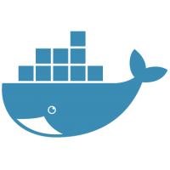
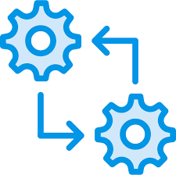
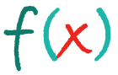
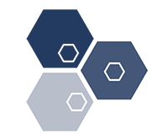
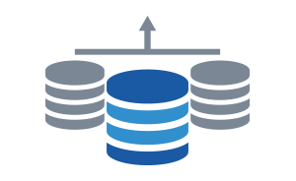
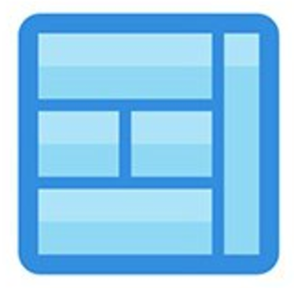
There are many ways to package and run
workloads in the cloud
Containers
Batches
Event-driven Functions
Microservices
Data Services
Monolithic Applications
Notes:
It is important to understand that workloads have, and always will, come in many shapes and sizes. Moving to the cloud does not change this fact - therefore any viable cloud-based solution must provide mechanisms to run workloads that vary. Starting with existing monolithic applications that are highly customized, cloud providers must offer methods to deploy everything from containers to serverless functions. We’ll get into the details about how Pivotal Cloud Foundry specifically addresses each.

Slide 29
Your goal: choose the right runtime for each workload
Containers
Batches
Event-driven Functions
Microservices
Data Services
Monolithic Applications
Container
Orchestrator (CaaS)
Application Platform
(PaaS)
Serverless Functions
(FaaS)
IaaS
Notes:
What we first want to do is define the major types of “as-a-service” paradigms, and then we can talk about what we offer. A couple of points:
Container Orchestration focuses on allowing organizations to package applications with some level of customizations, but with an agreed upon line of demarcation between what the infrastructure provides, and what the packaging of the application must provide.
Application Platforms, such as Pivotal Cloud Foundry, should provide everything required to build and run a complex system of interconnected microservices and containers. Orchestration, metrics, scalability, and all other “-ilities” should be provided. The end game here is to give developers a place to safely deploy applications in a consistent manner.
Serverless Functions refer to the ability to put a single set of reusable actions into an ephemeral container, and then host that independently from other components in the datacenter.

Slide 30
Choose the right tool for the job
Container
Orchestrator
Application Platform
Serverless Functions
Developer
Provides
CONTAINER
APPLICATION
FUNCTION
Tool
Provides
Container Scheduling
Primitives for Network, Routing, Logs & Metrics
Container Orchestrator
Container Orchestrator
Container Image & build
L7 Network & Routing
Logs, Metrics, Monitoring
Services Marketplace
Team, Quotas & Usage
Function execution
Function scaling
Event stream bindings
IaaS
Notes:
Each tool has its own purpose. We should be careful that we articulate the value each tool brings to the table and what it’s strengths and weaknesses are. We need to make sure to point out that as you move “up the stack” from Containers to Serverless, you have less control, but you have less that you are responsible for as well. Users need to make sure they’re picking the right tool for the job they need to accomplish.
Examples:
If you need to be able to run your application on a specific port, or need to co-mingle a couple applications right next to each other, then a Container Orchestrator (PKS) is a great solution.
If you have a webapp that runs without any heroic efforts to change from running on your laptop to production, then an Application Platform (PAS) is a great solution.
If you have a piece of code that needs to run when some event happens, instead of deploying an application with a very limited scope of work, consider writing that functionality to run as a Function as a Service and deploy to a Serverless Infrastructure (PFS)

Slide 31
Use the highest abstraction possible
Serverless Functions
Application Platform
Higher flexibility and less enforcement of standards
Lower development complexity and higher operational efficiency
Container Orchestrator
IaaS
Hardware
Your strategic goal: Push as many workloads as technically feasible to the top of the platform hierarchy
Notes:
The more you can let platforms take over responsibility for running your applications, the more free time you’ll have to add new functionality to those applications.
Whenever you build new application functionality, you should ask yourself “what do you want to manage going forward?” Do you want to have to manage an VM, a container, or just deploy a function?
The further up the stack you can keep your applications, the less overall plumbing you need to worry about maintaining in the future.

Slide 32
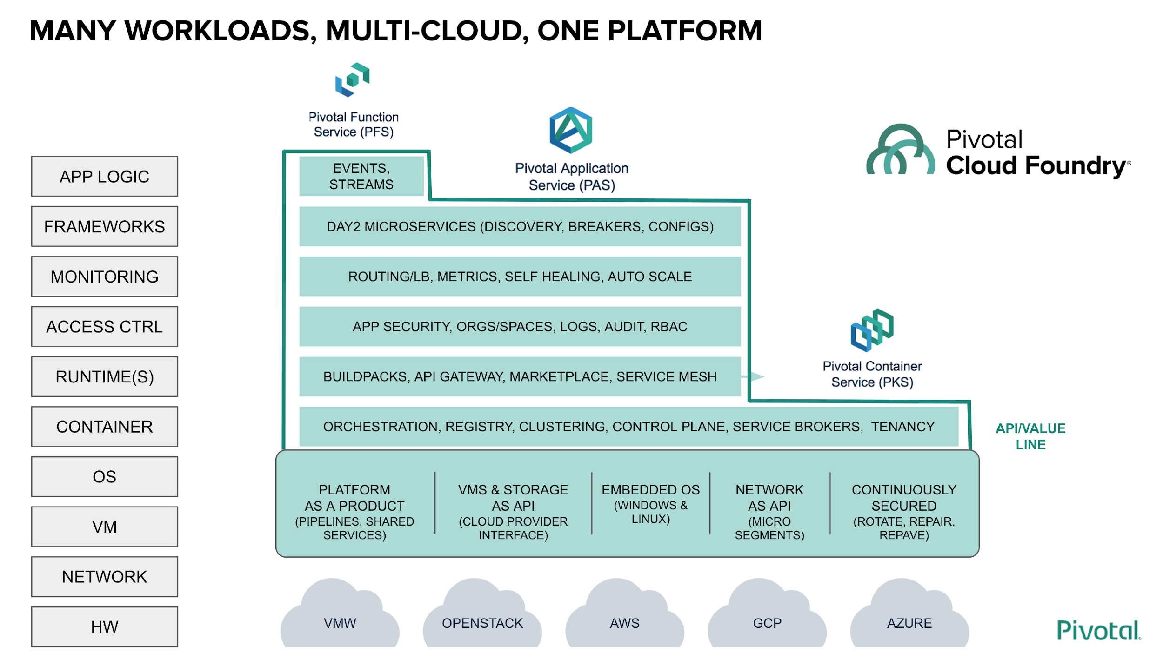

Slide 33

WE build the container
YOU build the container
Application Code & Frameworks
Buildpacks | Spring Boot | Spring Cloud | Steeltoe
Continuous
delivery
Github
Public Cloud Services
Pivotal Network
Open Service Broker API
Pivotal Application Service (PAS)
Pivotal Container Service (PKS)
Pivotal Function Service (PFS)
Pivotal Services Marketplace
Customer Managed Services
Concourse
> cf push
> kubectl run
> riff function create
Pivotal and
Partner Products
v1
CVEs
Product Updates
Java | .NET | NodeJS
Elastic | Packaged Software | Spark
v2
“3Rs”
v3
Embedded OS
(Windows & Linux)
NSX-T
Repair
— CVEs
Repave
Rotate
— Credhub
...
Concourse
CPI (15 methods)
vSphere
Openstack
AWS
Google Cloud
Azure & Azure Stack

Slide 34
PAS

Slide 35
Cloud Native Design - 12 factors
Codebase
One codebase tracked in revision control, many deploys
Dependencies
Explicitly declare and isolate dependencies
Configuration
Store config in the environment
Backing services
Treat backing services as attached resources
Build, release, run
Strictly separate build and run stages
Processes
Execute the app as one or more stateless processes
Port Binding
Export services via ports
Concurrency
Scale out via the process model
Disposability
Maximize robustness with fast startup and graceful shutdown
Dev/Prod Parity
Keep dev to prod as close as possible
Logs
Treat logs as event streams
Admin Processes
Run admin and management tasks as one-off processes

Slide 36

No More Tickets — Self-Service Provision and Deploy
Code Complete & Tested
cf push
Find available hosts
Install & configure runtime
Install & configure middleware
Pull application source code
Retrieve dependent libraries
Create application package
Install, configure dependent service(s)
Deploy container to host(s)
Load environment variables
Configure load balancer
Configure firewalls
Update service monitoring tools
Configure log collector
2 Days
1 Day
1 Day
¼ Day
¼ Day
¼ Day
2 Days
½ Day
¼ Day
2 Days
2 Days
3 Days
1 Day
Speed &
Consistency
~45 seconds
Application in Production
~15+ Days
Notes:
When the application code reaches the Pivotal Platform, it automatically initiates the deployment process without a single ticket, shrinking what could be over 15 days elapsed time into seconds.
After the code is complete and tested, the “CF Push” command takes the source code and initiates a sequence of activities that ultimately result in the application (or changes to the application) running in production.
Using buildpacks you can automate creation of deployable artifacts. PCF platform commands (e.g. cf push, cf scale, cf bind) also automate and streamline provisioning/deployment/scaling/de-provisioning of compute capacity. Together, these capabilities make spinning up new environments and compute capacity very simple, self-service and fast. Coupled with in-built role-based access control, multi-tenancy, quota management and isolation meant for an enterprise environment, you can enable developers to use the same platform in parallel without IT delays, and thus parallelize productivity.
With appropriate permissions, developers can at any time, log into an org/space to deploy and scale applications into a particular space by invoking simple platform commands through one of several mechanisms. The platform automates the details of provisioning, configuration and deployment of the application to containers. The power inherent in this much simpler model of capacity management radically simplifies and accelerates the developer experience.
CF Push
The simplicity of cf push hides how much power is packed in it. In addition to creating a deployable artifact via a buildpack, CF Push automates multiple other IT workflows that happen each time code needs to get to production in most enterprises – a process that usually takes days, weeks, and even months. As this illustration makes clear, a lot of that work is automated by PCF and the time it takes between wanting to deploy and having a running deployment shrinks from 15 days to 45 seconds.
Of course, this is a “stylized” interpretation of the relative time difference. These numbers are not hard and fast. Different enterprises may spend more or less time for each step. For example, for Allstate, that number is 100 days! Nevertheless, the conclusion is clear: there is a multiple orders of magnitude difference between current enterprise status quo and cf push! CF Push enables two key benefits for deployment:
- Speed: The automated workflow avoids manual IT ticketing systems with built in delays.
- Consistency: The automated workflow provides consistency that avoids the various types of errors that might result from manual provisioning, configuration, deployment and monitoring set ups. The result is the same, each time it is run.
This speed and consistency to provision, configure, deploy and monitor application deployment quickly is absolutely critical for an organization trying to deliver code fast in a DevOps/CD world, where new features can be released multiple times a day. PCF eliminates the disincentive to deploy often and more frequently – it takes seconds for each deploy, not days.
Benefits
CF Push is only one command that streamlines a collection of IT workflows. Other commands such as cf scale, bind, etc. similarly accelerate many other processes. The various PCF constructs, commands and buildpacks collectively make possible a number of benefits.
Rapid, On-Demand, Self-Service Provisioning & Automatic Configuration: The platform commands (cf push, bind, scale) eliminate the tediousness of provisioning and configuring environments, allowing developers to work with high level constructs (such as applications and services) to move fast.
Enterprise Fit: PCF Orgs and Spaces organizational constructs were designed with the hierarchical structure and multi-tenant needs of the enterprise in mind, where a single pool of infrastructure is shared efficiently among multiple, stakeholders.
Role Based Access Control (RBAC): RBAC enables strikes the appropriate balance between individual empowerment and centralized control that is necessary for enterprises wanting to move fast.
Quota Management & SLA Assurance: With platform managed resource quotas, developers and teams can be assured of receiving the allocated resources and not having to deal with contention created by noisy neighbors, thereby enabling enforcement of internal SLAs.
Elastic, Fluid, Multi-tenanancy: Since the platform provisions, configures, scales and disposes container resources from a large global pool, development teams can take advantage of “pooling efficiencies” and easily provision incremental resources temporarily without needing to contend for dedicated peak resources, as the global resource pool is shared dynamically in a true multi-tenant, cloud manner.
Simplified Service Discovery: With platform commands such as CF Bind/Unbind, service discovery and access becomes a simple command whose semantics are preserved regardless of how the application scales. Contrast this with what you would need to do for example with manually providing service credentials to each application instance in the absence of a platform each time it was scaled.
Easy Scaling: The platform eliminates a lot of the IT processes that would be required to properly scale you application. Beyond provisioning, configuring and deploying code to additional compute capacity, scaling requires updating load balancers to route traffic appropriately to new instances. Similar processes happen when scaling down. All this is automated by PCF.
Consistency: The automation provided by buildpacks and platform commands enable repeatability, thereby eliminating many of the deployment concerns rooted in environmental disparity with snowflake deployments, e.g., between individual developers or environments (dev vs. production).

